Slide 1

GOTCHA Password Hackers!
Jeremiah Blocki
Manuel Blum
Anupam Datta
Presented by Arunesh Sinha
AISec2013

Slide 2

Questions
Jeremiah Blocki was not able to make it because BLS International did not return his passport.
Arunesh Sinha agreed to present in his place.
Please address any questions to jblocki@cs.cmu.edu

Slide 3
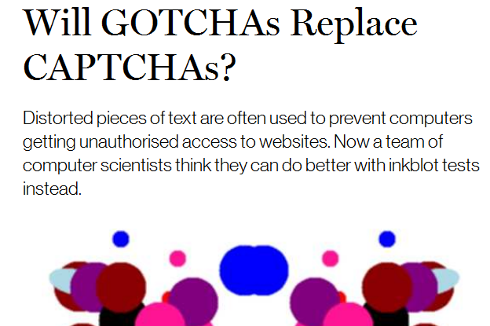
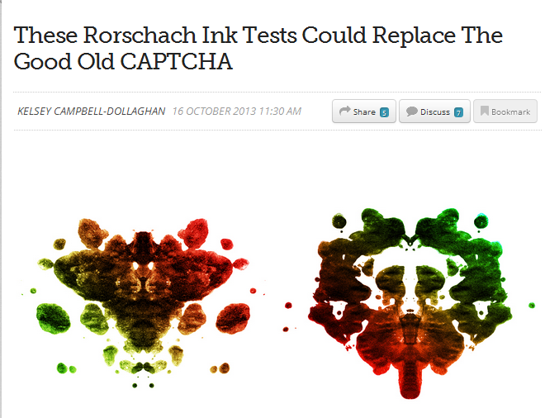
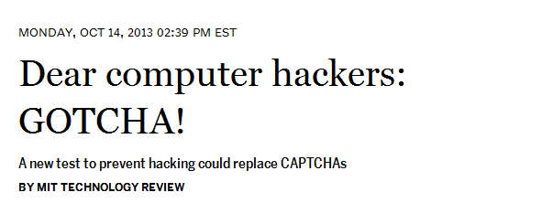
GOTCHAs in the Blogosphere
Answer: No! GOTCHAs address a fundamentally different problem than CAPTCHAs.
Notes:
After Jeremiah posted the paper on arXiv MIT Technology review wrote an article about the paper. Unfortunately, they never contacted Jeremiah before they posted the article so all of the articles are not accurate. It is very easy to answer the question in the title. No! GOTCHAs will not replace CAPTCHAs they solve a completely different problem.

Slide 4
Outline
Offline Dictionary Attacks
Goal: Require Human Interaction
GOTCHAs
User Study
Challenge

Slide 5





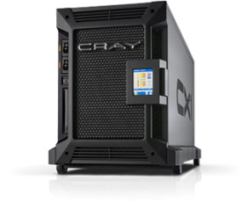

Offline Dictionary Attack
jblocki, 123456
Username
jblocki
Salt
89d978034a3f6
Hash
85e23cfe0021f584e3db87aa72630a9a2345c062
SHA1(12345689d978034a3f6)=85e23cfe0021f584e3db87aa72630a9a2345c062
+
Notes:
GOTCHAs are intended to address a specific type of attack against passwords called an offline dictionary attack. When a user creates an account the server stores a password file with a cryptographic hash of the user’s password. If an adversary is able to breach the server and recover this password file then he check a password guess by evaluating the hash function --- without getting locked out after several incorrect guesses.

Slide 6






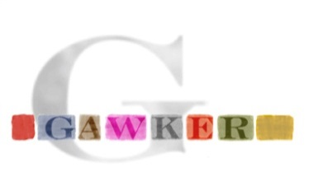

A Common Problem
Password breaches at major companies have affected millions of users.
Notes:
Unfortunately, offline dictionary attacks are quite common. Password breaches at major companies have affected millions of users.

Slide 7
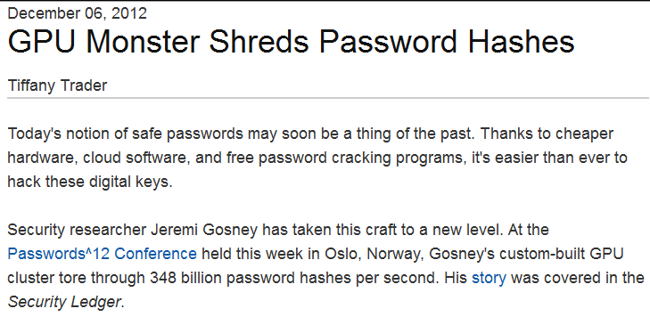
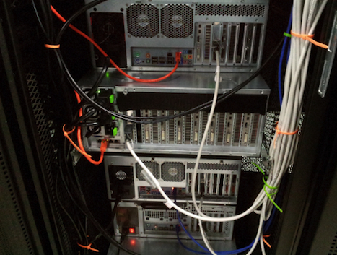
Notes:
Offline dictionary attacks are also very powerful. Some password hash functions can be evaluated at 348 billion hashes per second! How can we defend against these attacks?

Slide 8


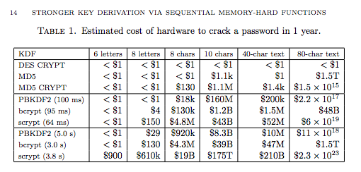
Better Hash Functions
Source: Percival, C. Stronger Key Derivation via Sequential Memory-Hard Functions.
Notes:
Note: This slide could be skipped if the presentation is too long.

Slide 9




Costly Hash Functions
Tradeoff
Notes:
One proposed defense is to intentionally make the cryptographic hash function more expensive to evaluate by using a cryptographic hash function like BRCRYPT or sCrypt. The tradeoff is that making the hash function more expensive to evaluate increases costs for the adversary and a legitimate server.
Note: This slide could be skipped if the presentation is too long.

Slide 10
Outline
Offline Dictionary Attacks
Goal: Require Human Interaction
  Failed Approach: CAPTCHAs
  Human Only Solvable Puzzles (HOSPs) [CHS 2006]
  Limitations
GOTCHAs
User Study
Challenge

Slide 11

Basic Idea: Require Human Interaction
Goal:
+
Notes:
The basic idea behind GOTCHAs is to make the authentication protocol interactive and exploit hard artificial intelligence problems so that an adversary who wants to verify a password guess by simulating the authentication protocol will to interact with a human to verify each guess.

Slide 12
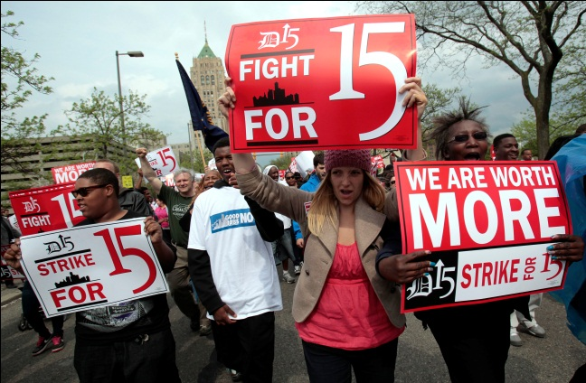
Basic Idea: Require Human Interaction
Goal:
+
Notes:
If the adversary needs to interact with a human to verify each password guess then the cost of an offline attack will increase dramatically.

Slide 13
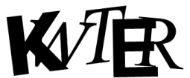
A Failed Attempt
jblocki, 123456
KWTER
123456
Answer: KWTER
Username
jblocki
Salt
89d978034a3f6
Hash
1f88ecdcb0c25e8ae1ed1c9ce6f2e2e6dcfb0e21
CAPTCHA
SHA1(123456KWTER89d978034a3f6)=1f88ecdcb0c25e8ae1ed1c9ce6f2e2e6dcfb0e21
Notes:
A natural attempt to achieve this goal is to exploit CAPTCHAs. To authenticate the user would have to enter his password, and then solve a puzzle that was generated using his password as a random seed. The answer to this puzzle is appending to the password before we compute the hash.

Slide 14
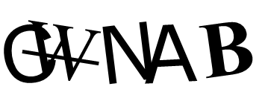
A Failed Attempt
SHA1(passwordGWNAB89d978034a3f6)=4e108b3c12b4a1c6b8670685bb9a63e40b8d7a1d
password
Answer: GWNAB
Username
jblocki
Salt
89d978034a3f6
Hash
1f88ecdcb0c25e8ae1ed1c9ce6f2e2e6dcfb0e21
CAPTCHA
Notes:
Unfortunately, this approach fails because a CAPTCHA generator outputs the answer as well as the puzzle. When the adversary simulates the authentication protocol to verify a password guess he is given the answer to the puzzle directly. There is no need to interact with a human.

Slide 15

Human Only Solvable Puzzles
jblocki, 123456
KWTER
123456
Username
jblocki
Salt
89d978034a3f6
Hash
1f88ecdcb0c25e8ae1ed1c9ce6f2e2e6dcfb0e21
…
SHA1(123456KWTER89d978034a3f6)=1f88ecdcb0c25e8ae1ed1c9ce6f2e2e6dcfb0e21
[CHS 2006] Mitigating dictionary attacks on password-protected local storage
Notes:
In 2006 Canetti et al proposed a fix, which they called human only solvable puzzles. The basic idea was to stuff a hard drive with CAPTCHA puzzles and throw out the solutions. Now during the authentication protocol the users password is used as a random seed to select a puzzle. As before the user solves the puzzle and the answer is appended to the users password.
In case people ask the authors are Ran Canetti, Shai Halevi, Michael Steiner, and the paper was published in CRYPTO 2006.

Slide 16
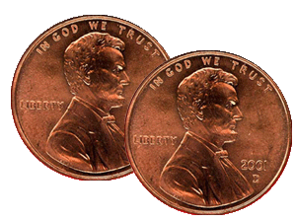
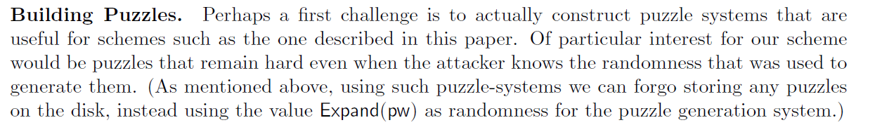
Limited Protection
SHA1(passwordGWNAB89d978034a3f6)=4e108b3c12b4a1c6b8670685bb9a63e40b8d7a1d
Open Question: Can we build a puzzle system that doesn’t have this limitation?
GWNAB
password
Username
jblocki
Salt
89d978034a3f6
Hash
1f88ecdcb0c25e8ae1ed1c9ce6f2e2e6dcfb0e21
[CHS 2006] Mitigating dictionary attacks on password-protected local storage
…
GWNAB
Notes:
This approach does provide some protection against offline dictionary attacks, but this protection is limited by the space on the hard drive. Once the adversary has paid humans to solve all of the CAPTCHAs on the hard drive then he can once again execute a fully automated offline attack. Canetti et al acknowledged the limitation of their approach. Their main open question was to build a puzzle system that doesn’t have this limitation. This is the challenge that we begin to address.

Slide 17
Outline
Offline Dictionary Attacks
Goal: Require Human Interaction
GOTCHAs
  Example Construction
  GOTCHAs vs HOSPs
  Security
User Study
Challenge
Notes:
Before formally defining GOTCHAs we will introduce them using an example construction. We will then compare GOTCHAs and HOSPs and discuss the security properties that a GOTCHA should satisfy.

Slide 18
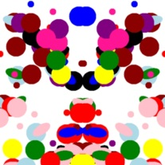
Inkblots
Easy to generate on computer
Human Imagination
  Evil Clown?
Notes:
Our construction relies on Inkblot images, which can be generated by a computer. While the images are random, we often imagine patterns in this images. For example, I see an evil clown when I look at this image.

Slide 19
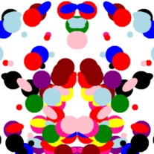
GOTCHA: Account Creation
jblocki, 123456
…
evil clown, … ,steroid cow
…
123456
Username
jblocki
Salt
89d978034a3f6
Labels
Steroid cow … Evil clown
Hash
0340eebc16d09e5a747a9ac879019af61e460770
Inkblots
SHA1(123456987654321089d978034a3f6)=
0340eebc16d09e5a747a9ac879019af61e460770
Notes:
To create an account the user will send his password and the server will use the password to generate ten inkblot images. The user will label these images using his own imagination. The server will then pick a random permutation, and append this permutation to the user’s password before hashing. The labels are stored in the password file in permuted order.

Slide 20
GOTCHA: Authentication
jblocki, 123456
…
Steroid cow, …, Evil clown
…
123456
evil clown, … ,steroid cow
Username
jblocki
Salt
89d978034a3f6
Labels
Steroid cow … Evil clown
Hash
0340eebc16d09e5a747a9ac879019af61e460770
Inkblots
SHA1(123456987654321089d978034a3f6)=
0340eebc16d09e5a747a9ac879019af61e460770
Notes:
Later when the user wants to authenticate he will enter his password. The server will send back his labels with ten inkblot images. If the user’s password is correct then these are the same inkblot images he saw when he created the account. The user will match the inkblot images with his labels, and send back the resulting permutation. If the matching is correct then the user will be able to authenticate.

Slide 21
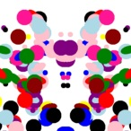

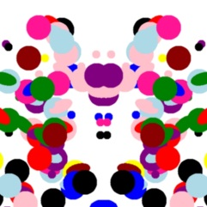
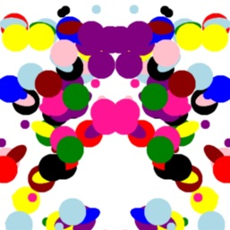
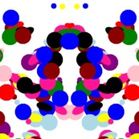
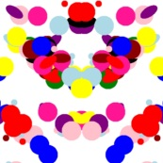
GOTCHA: Authentication
jblocki, 1234567
…
Steroid cow, …, Evil clown
1234567
…
Steroid cow, … ,evil clown
Username
jblocki
Salt
89d978034a3f6
Labels
Steroid cow … Evil clown
Hash
0340eebc16d09e5a747a9ac879019af61e460770
Inkblots
SHA1(1234567012345678989d978034a3f6)=
babb03d14600ef101b4a46f86b0c4ae3f25aa1a7
Notes:
Note that if the user enters the wrong password then he will see 10 different inkblot images. The user may not be able to match the images correctly. Authentication will fail in any case because the user entered the wrong password.

Slide 22
GOTCHAs vs HOSPs
Human Involved in Generation of Puzzle
  HOSP puzzles are generated without human interaction
Puzzle need not be meaningful to user if he enters the wrong password
  HOSP puzzles must always be human-solvable
Notes:
There are two key differences between GOTCHAs and HOSPs. First, the GOTCHA challenges were generated with human interaction (e.g., the human had to label the images) while HOSPs are generated automatically. Second, HOSP puzzles must always be human-solvable, but we only require that our puzzles are human-solvable when the user enters the correct password.

Slide 23




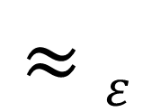


Security: Real vs Fake Puzzles
Real Puzzles
Fake Puzzles
123456
123456
111111
Inkblots
Inkblots
Inkblots
$$≈ε$$
$$π$$
$$π$$
Labels
Inkblots (permuted order)
Labels
Inkblots (permuted order)
Notes:
The first security property that we need to satisfy is indistinguishability of real vs fake puzzles. The first view represents the case when the password is correct. The user labels 10 inkblot images, and we see the inkblots in permuted order. The second view represents the case when the password is wrong. The user labels the original 10 inkblot images and we see a completely unrelated set of inkblots. If these views are nearly indistinguishable then the adversary won’t be able to tell if the password is correct without trying to solve the puzzle.

Slide 24






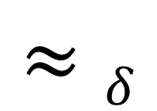
Security: Real vs Fake Solutions
Real Solution
Fake Solution
123456
123456
Distribution R
Inkblots
Inkblots
$$≈δ$$
$$Hmin\left(R\right)≥μ$$
$$π′$$
$$π$$
$$π$$
Solution
$$π$$
Fake Solution
Labels
Inkblots (permuted order)
Labels
Inkblots (permuted order)
$$π′$$
Notes:
The second security property we need to satisfy is that the puzzles should be hard to solve. In view 1 we have the actual solution, and in view 2 a fake solution is chosen from a distribution with high minimum entropy. If the adversary cannot distinguish these views then he will need to try at least 2$μ$
guesses on average to solve the puzzle.

Slide 25
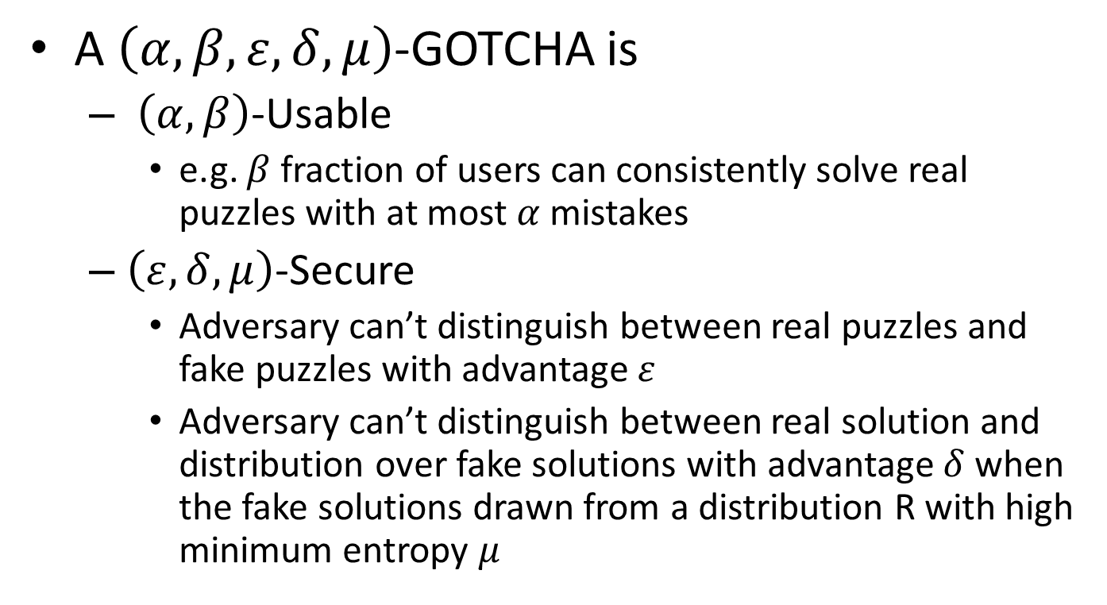
Definition
A $\left(α,β,ε,δ,μ\right)$-GOTCHA is
  $\left(α,β\right)$-Usable
    e.g. $β$ fraction of users can consistently solve real puzzles with at most $α$ mistakes
  $\left(ε,δ,μ\right)$-Secure
    Adversary can’t distinguish between real puzzles and fake puzzles with advantage $ε$
    Adversary can’t distinguish between real solution and distribution over fake solutions with advantage $δ$when the fake solutions drawn from a distribution R with high minimum entropy $μ$
Notes:
Note:

Slide 26
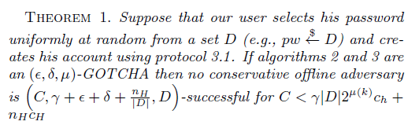


Offline Attacks are Expensive!
$$nHcH$$
Cost of Human Labor
$$γ\left|D\right|2μch$$
Cost of Computation
Notes:
Informally, our main theorem says that offline attacks against our authentication protocol are expensive. To be successful the adversary will either have to pay humans to solve lots of puzzles or the adversary will have to enumerate over a large space of potential solutions for each password guess.
Note: you don’t have to explain this theorem in detail. Just highlight the main point. C is the adversaries cost, D is the space of passwords and the middle term is the probability that the adversary’s attack is successful.

Slide 27
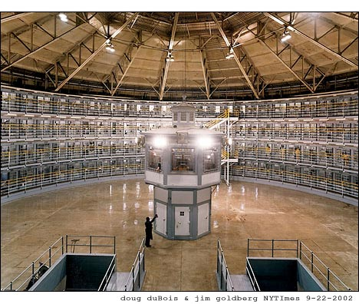
What Does GOTCHA stand for?
Generating panOptic Turing Tests to Tell Computers and Humans Appart
Notes:
A panoptic prison allows a guard to easily monitor prisoners. We use the term panoptic because there are no hidden inputs when the adversary is simulating the protocol.
Note: This slide could be easily skipped.

Slide 28
Outline
Offline Dictionary Attacks
Goal: Require Human Interaction
GOTCHAs
User Study
  Protocol
  Results
  Discussion
Challenge

Slide 29
Study Protocol
Participants recruited on Amazon Mechanical Turk
Labeling Phase
  Participants asked to label 10 Inkblot images
  Paid $1
Matching Phase
  Participants asked to match their labels after 10 days.
  Paid $1 (even if answers were wrong)
Notes:
Emphasize: We waited 10 days because we wanted to make sure that people had plenty of time to forget why they selected each label.
To avoid positively biasing our results we told participants that they would be paid even for wrong answer.

Slide 30
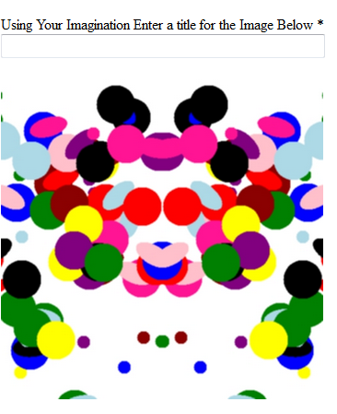
Labeling Phase
10 Inkblots
Compensation: $1
Seventy Participants
Notes:
Seventy participants completed the labeling phase.

Slide 31
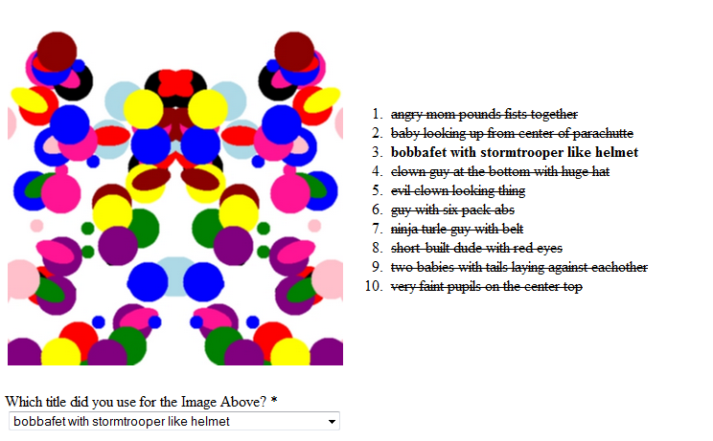
Matching Phase
10 Days Later
Compensation: $1 (even for wrong answers)
58 Participants
Notes:
58 participants completed the matching phase. They were paid $1 even for wrong answers.

Slide 32
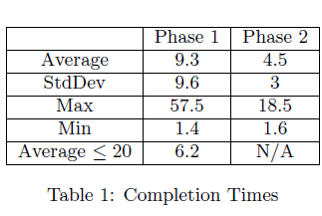
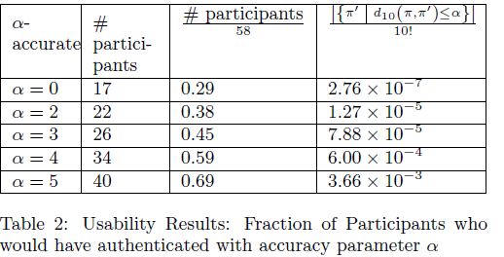
Results
69% of users matched at least half of their images correctly
Notes:
Pros: If we set our matching threshold at 50% then almost 70% of our users would have authenticated correctly.
Cons: IT took users a couple minutes on average to label and match their inkblots. Some participants were not accurate.

Slide 33
Discussion
Personal Experience vs. Study
  Incentives
  Better Instructions?
Time Barrier
Improved Constructions
  Better Inkblots
  Reject Confusing Inkblots
  Multiple GOTCHAs?
Notes:
There is some evidence that our results were negatively biased by lack of incentives. During our prelimanary experiments on ourselves/friends/colleagues the accuracy was much higher. Several users generated their labels much faster than other users (possibly because they just wanted to earn the $1). These user’s had very low matching accuracy later.
We are exploring several options for improvements to address the time barrier. Different Inkblot generation algorithms, and allowing users to reject inkblots that they find confusing. If we can find other GOTCHA constructions then we could allow users to pick their GOTCHA (e.g. some users might like inkblots, others might like something else).

Slide 34
Outline
Offline Dictionary Attacks
Human Only Solvable Puzzles
GOTCHAs
User Study
Challenge

Slide 35

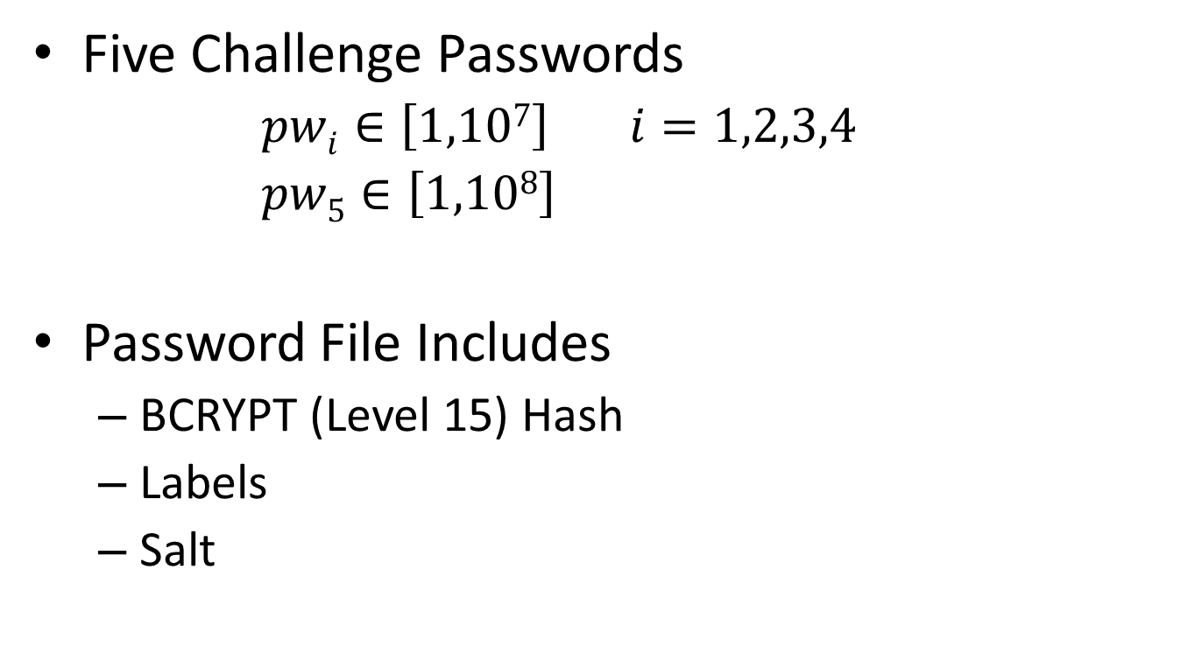
GOTCHA Challenge
Five Challenge Passwords
  $pwi∈\left[1,107\right] i=1,2,3,4$
  $pw5∈\left[1,108\right]$
Password File Includes
  BCRYPT (Level 15) Hash
  Labels
  Salt
Source: http://www.cs.cmu.edu/~jblocki/GOTCHA-Challenge.html
Notes:
We want to encourage AI and Security researches to attack our construction. We generated five random passwords. To make the challenge tractable for AI researchers we selected the first four passwords from a small space. However, we also used BCRYPT to discourage a direct brute force attack where the attacker just enumerates over all passwords and all permutations.

Slide 36
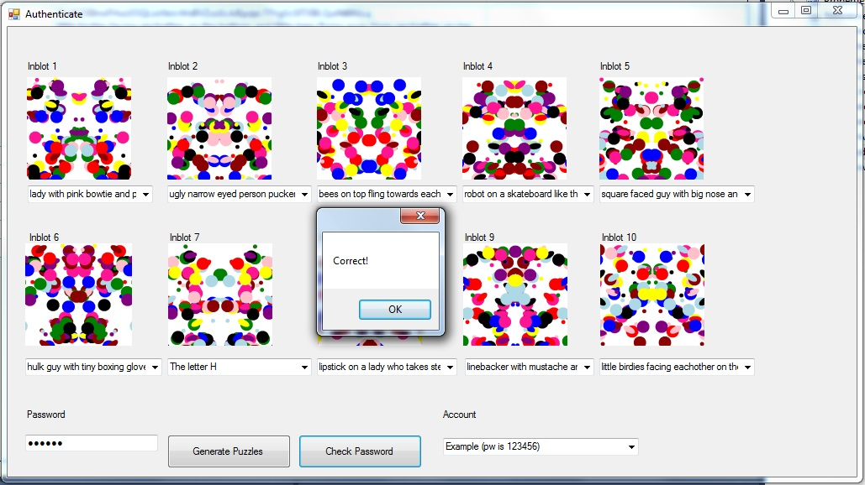
GOTCHA Challenge
Source: http://www.cs.cmu.edu/~jblocki/GOTCHA-Challenge.html
Notes:
Here is an example of the challenge when the password is 123456. Note: The source code for the challenge can be found online.

Slide 37

GOTCHA Challenge
 | Password | Winner | Institution | Date Solved
Example | 123456 | Harry Q. Bovik | Carnegie Mellon University | 7/17/2013
Challenge 1 | ? | N/A | N/A | N/A
Challenge 2 | ? | N/A | N/A | N/A
Challenge 3 | ? | N/A | N/A | N/A
Challenge 4 | ? | N/A | N/A | N/A
Challenge 5 | ? | N/A | N/A | N/A
Source: http://www.cs.cmu.edu/~jblocki/GOTCHA-Challenge.html
Notes:
This is the current challenge leaderboard. Fictional character Harry Q. Bovik gets credit for solving the example challenge.

Slide 38
Thanks for Listening!
Please direct questions to Jeremiah Blocki jblocki@cs.cmu.edu

